Slide 1
Smart Trash Bin
Author: Thawanrat Atthawiwatkul Student ID:62011277
Author: Tinchupeam Weerayutvilai Student ID:62011281

Slide 2
Topic
What is smart trash bin?
Hardware
Ultrasonic sensor HC_SR04
Operation
Schematic Diagram
Block Diagram
Flowchart
Library
Code
Demo
Improvement & Conclusion

Slide 3
What is smart trash bin?

Slide 4


What is smart trash bin?
Our smart trash bin is a bin using IOT technology to measure inside of the trash bin and tell in percentage.

Slide 5
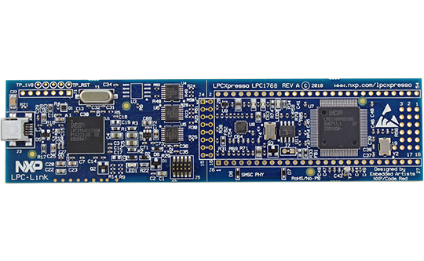
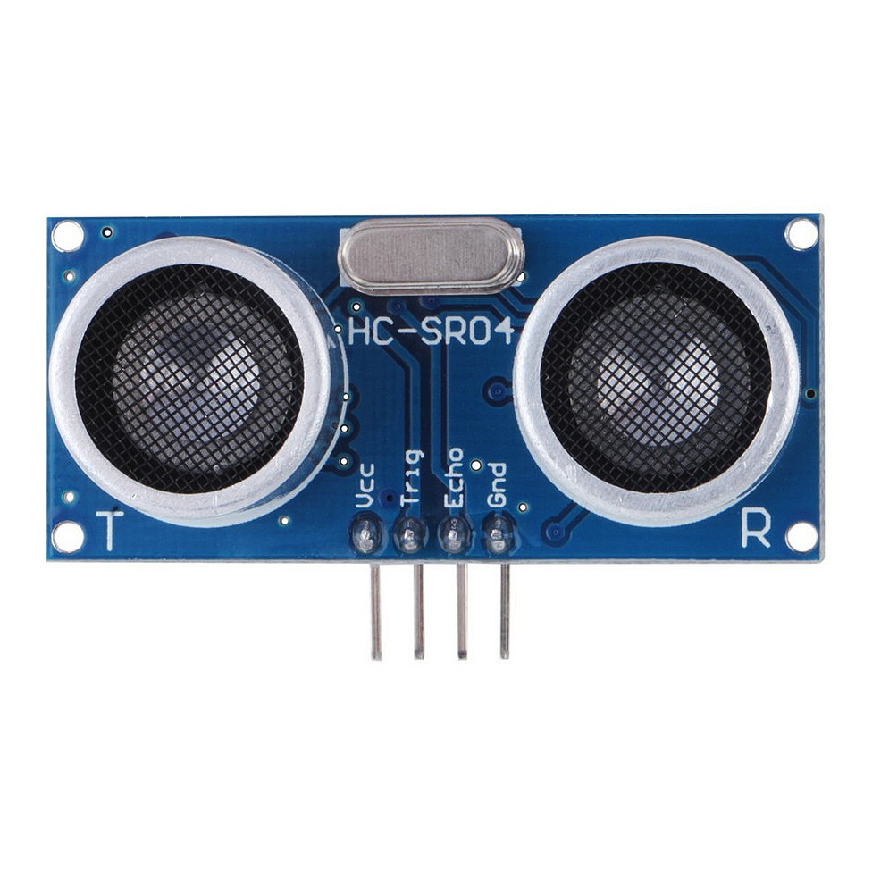
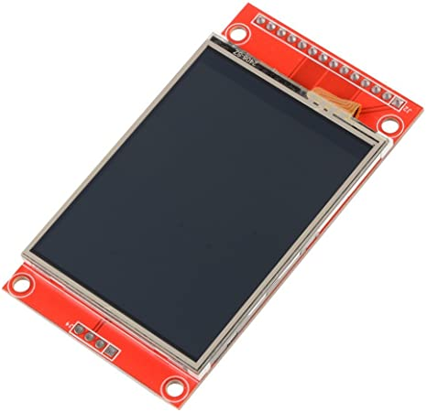
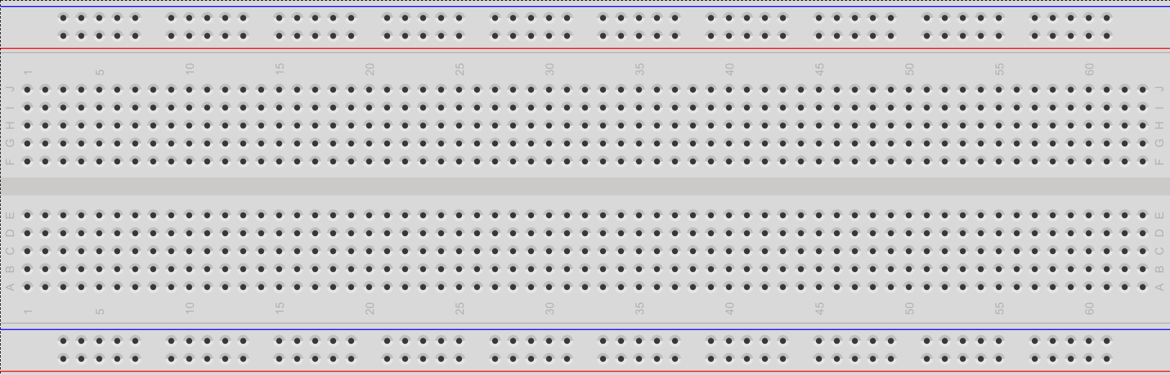
Hardware
LPCXPRESSO LPC1769
Ultrasonic sensor HC-SR04
LCD screen
Bread board

Slide 6
Ultrasonic Sensor HC-SR04
The HC-SR04 is one of the lowest cost Sonar-based distance sensor options available. It operates off of 5V DC power. The detection range is 3-400 cm with around a 15 degree beam width. Like most Sonars, it more readily detects large hard objects that reflect sound, so it might not see something soft like a fluffy cat. It uses a short 40 kHz ultrasonic ping that humans can't hear and then listens for the ping signal to return after reflecting off an object. The time delay for the reflected signal to echo back is used to measure the distance using a simple scaling calculation based on the speed of sound in air.

Slide 7
Ultrasonic Sensor HC-SR04
There are two tranducers, one to transmit and one to receive. Two transducers turn out to be cheaper, since a higher voltage is needed to transmit and switching modes using only one transducer takes a lot of analog circuitry.

Slide 8
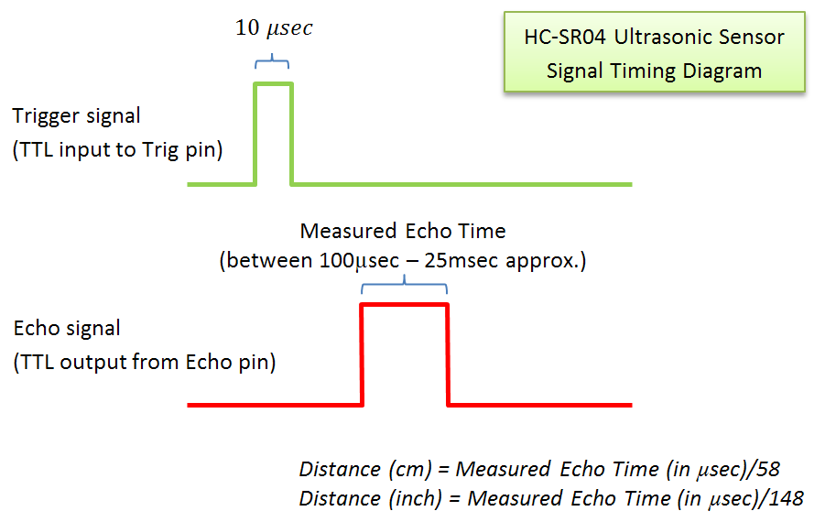
Operation
As seen in the timing diagram below, only two signal pins are used. Trigger starts a measurement cycle and sends out a short ultrasonic pulse (eight cycles at 40Khz) and then listens for a reflected signal (echo). Several cycles at 40Khz are needed for the analog receiver circuit to detect the reflected signal. The width of the echo pulse output pin indicates distance. A hardware timer would typically be used to measure the echo pulse width. A simple divide operation can then scale the value to cm or inches, if needed.

Slide 9
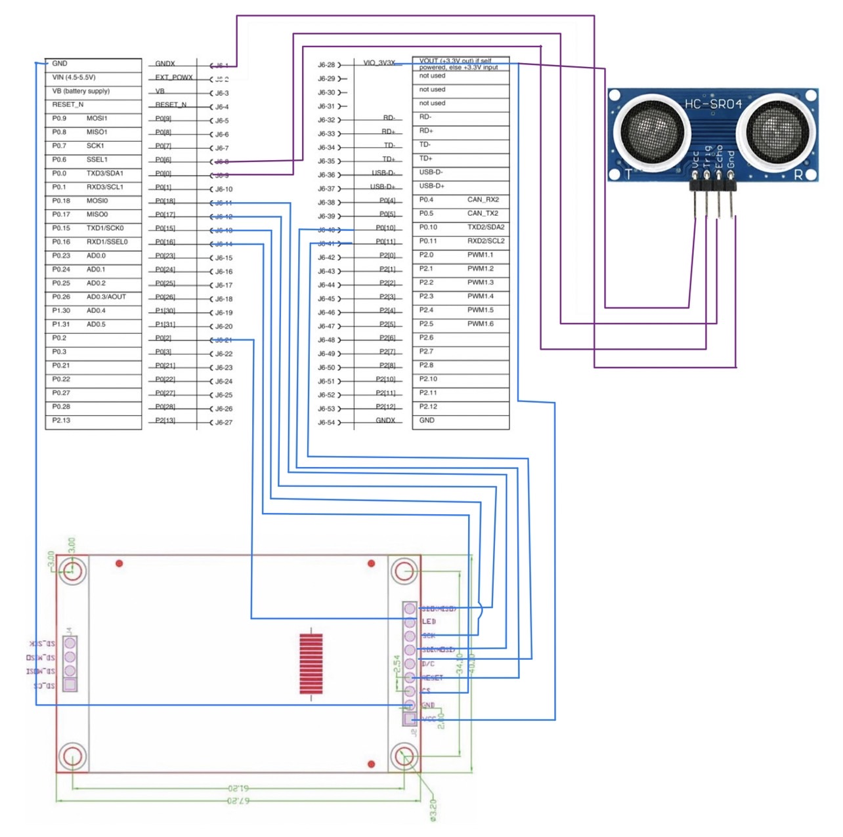
Schematic Diagram

Slide 10
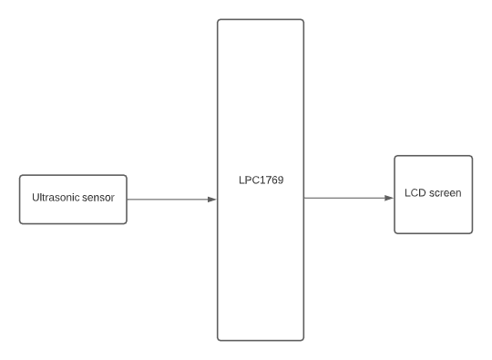
Block Diagram

Slide 11
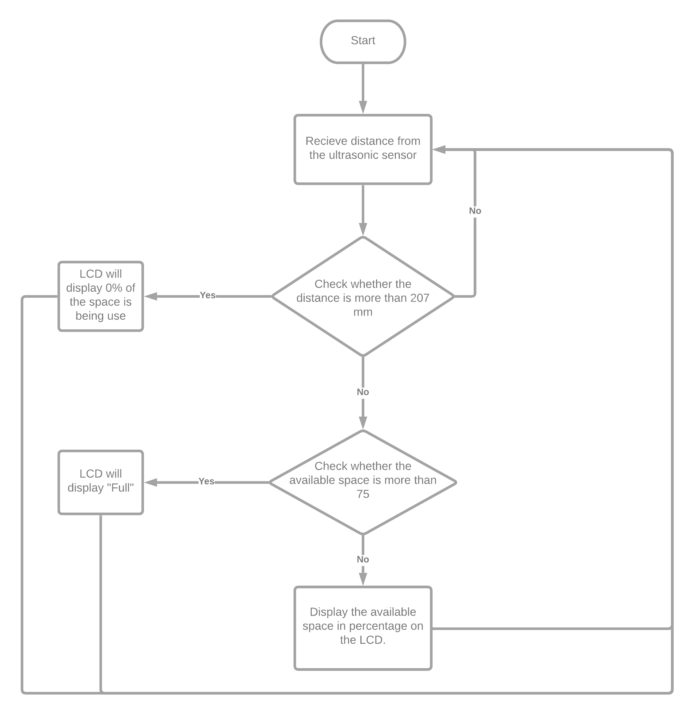
Flowchart

Slide 12
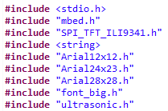
Library

Slide 13
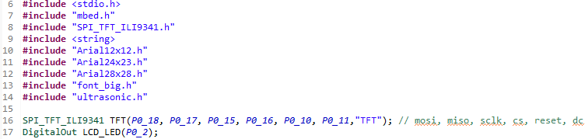
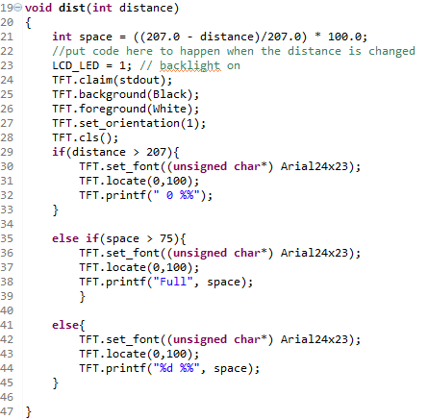
Code

Slide 14
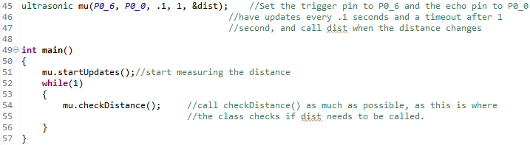
Code(2)

Slide 15

Demo Time
Smart Trash Bin

Slide 16

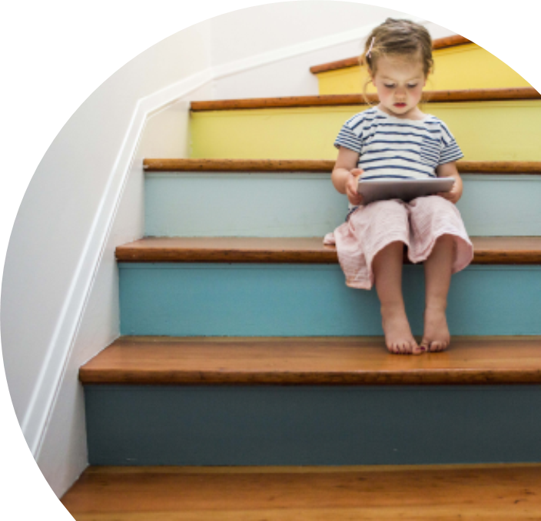
Improvement & Conclusion
We will make the bin door open automatically when the ultrasonic sensor can detect someone nearby using servo motor to power the servo leg to open the bin’s door.
The project uses the knowledge we have learnt from the lecture and lab. We also get to work in a team and create new useful things. We also experience many errors during work but eventually we find the right solution on time.

Slide 17
Thank you
Author: Thawanrat Atthawiwatkul Student ID:62011277
Author: Tinchupeam Weerayutvilai Student ID:62011281

